Slide 2
ABOUT US
25Twenty Capital is an opportunistic investment firm that desires to faithfully steward the resources we’ve been given in order to add value to the properties and business we own, the communities we live in, and to the lives of our investors and their families.

Slide 3
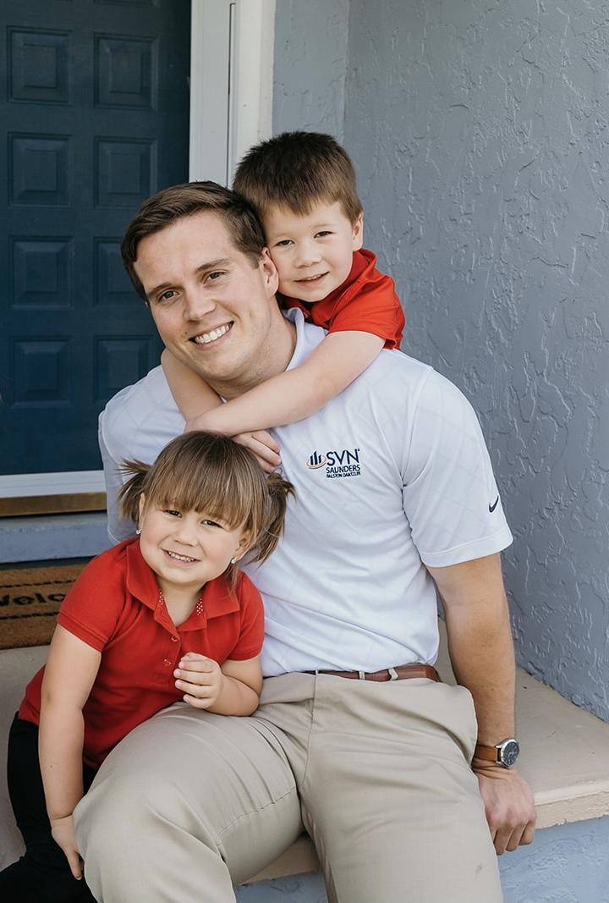
PRINCIPAL BIO
AUGIE SCHMIDT
FOUNDER & CEO
Augie is the Founder & CEO of 25Twenty Capital. He is a seasoned professional in the Commercial Real Estate arena in Central Florida and has directly orchestrated the acquisition & disposition approximately $57MM of assets throughout his brokerage career. In 2019, Augie was ranked #3 out of 1,600+ within his firm.
The foundation of being a Top Performing Commercial Broker has given Augie the ability & expertise to analyze, underwrite, and execute strategic plans for Commercial Real Estate Assets on behalf of 25Twenty Capital.
Augie lives in Lakeland with his beautiful wife Britney and their two kids AJ and Baylin.

Slide 4
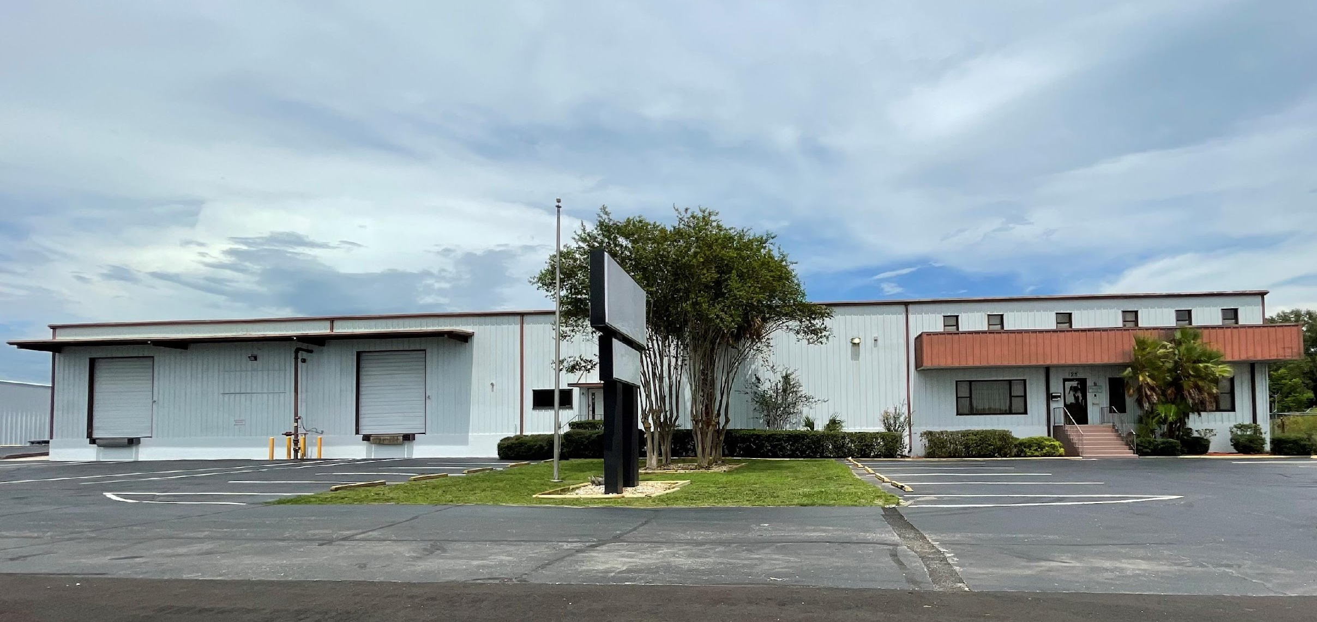
DEAL SUCCESS STORY
23 SPIRIT LAKE RD - INDUSTRIAL
This free-standing industrial building is 30,000sf and located in one of the Nation’s fastest growing industrial real estate markets, Central Florida along the I-4 Corridor. We secured this asset with a relationship from our deep roots in Central Florida and were able to construct creative financing that was attractive to all parties involved.
When we exited the deal at the end of 2021, our investors saw a Cash on Cash return of 341% within 8 months.

Slide 5
STRUCTURE
Fix Wheels
5-20+%
80-95%
8%
50/50
General Partnership Equity
Limited Partner Equity
Preferred Return
Split Between LP & GP once preferred return is reached
We structure our deals in a way that gives investors the assurance & confidence that we are going to perform. In every deal, we have skin in the game and we do not benefit on return on investment until the Limited Partner Equity reaches a certain threshold. <- fix

Slide 6
MARKET OVERVIEW
$3 BILLION
$1 BILLION
$2 BILLION
Freedom to invent
Selectively inclusive market
Serviceable available market
Opportunity to build
Fully inclusive market
Total addressable market
Few competitors
Specifically targeted market
Serviceable obtainable market

Slide 7
MARKET COMPARISON
$3B
$2B
$1B
OPPORTUNITY TO BUILD
FREEDOM TO INVENT
FEW COMPETITORS
Addressable market
Serviceable market
Obtainable market

Slide 9
FOCUS
VALUE-ADD
OPPORTUNITY DRIVEN
Our product makes consumer lives easier, and no other product on the market offers the same features
Our target audience is Gen Z (18-25 years old)
COST SAVINGS
EASY TO USE
Reduce expenses for replacement products
Simple design that gives customers the targeted information they need

Slide 10
DEAL SUCCESS STORY
CONTOSO
Our product is priced below that of other companies on the market
Design is simple and easy to use, compared to the complex designs of the competitors
Affordability is the main draw for our consumers to our product

Slide 11
MARKET COMPARISON
$3B
$2B
$1B
OPPORTUNITY TO BUILD
FREEDOM TO INVENT
FEW COMPETITORS
Addressable market
Serviceable market
Obtainable market

Slide 12
PROBLEM
MARKET GAP
Few, if any, products on the market help customers like we do
CUSTOMERS
66% of US consumers spend money on multiple products that only partially resolves their issue
FINANCIALS
Millennials account for about a quarter of the $48 billion spent on other products in 2018
COSTS
Loss of productivity costing consumers thousands of dollars

Slide 13
PRODUCT OVERVIEW
UNIQUE
Only product specifically dedicated to this niche market
FIRST TO MARKET
First beautifully designed product that's both stylish and functional
TESTED
Conducted testing with college students in the area
AUTHENTIC
Designed with the help and input of experts in the field

Slide 14
PRODUCT BENEFITS
Cool and stylish product
Areas for community connections
Online store and market swap

Slide 15
COMPANY OVERVIEW

Slide 16
Our Approach
OPPORTUNISTIC
We based our research on market trends and social media
DESIGN
We believe people need more products specifically dedicated to this niche market
RESEARCH
Minimalist and easy to use

Slide 17
OUR COMPETITION
CONTOSO
COMPETITORS
Our product is priced below that of other companies on the market
Design is simple and easy to use, compared to the complex designs of the competitors
Affordability is the main draw for our consumers to our product
Company A Product is more expensive
Companies B & C Product is expensive and inconvenient to use
Companies D & E Product is affordable, but inconvenient to use

Slide 18
OUR COMPETITION
CONVENIENT
CONTOSO
Competitor A
AFFORDABLE
EXPENSIVE
Competitor D
Competitor C
Competitor B
Competitor E
INCONVENIENT

Slide 19
GROWTH STRATEGY
FEB 20XX
Roll out product to high profile or top-level participants to help establish the product
MAR 20XX
Release the product to the general public and monitor press release and social media accounts
OCT 20XX
Gather feedback and adjust product design as necessary

Slide 20
TRACTION
Forecasting for success
KEY METRICS
 | Clients | Orders | Gross revenue | Net revenue
20XX | 10 | 1100 | $10,000 | $7,000
20XX | 20 | 200 | $20,000 | $16,000
20XX | 30 | 300 | $30,000 | $25,000
20XX | 40 | 400 | $40,000 | $30,000
REVENUE BY YEAR

Slide 21
TWO-YEAR ACTION PLAN
DRAFT BLUEPRINTS
GATHER FEEDBACK
DELIVER TO CLIENT
20XX
JAN
FEB
MAR
APR
MAY
JUN
JUL
AUG
SEP
OCT
NOV
DEC
20XX
JAN
FEB
MAR
APR
MAY
JUN
JUL
AUG
SEP
OCT
NOV
DEC
RUN FOCUS GROUPS
TEST DESIGN
LAUNCH DESIGN

Slide 22
FINANCIALS
 | Year 1 | Year 2 | Year 3
INCOME
Users | 50,000 | 400,000 | 1,600,000
Sales | 500,000 | 4,000,000 | 16,000,000
Average price per sale | 75 | 80 | 90
Revenue @ 15% | 5,625,000 | 48,000,000 | 216,000,000
GROSS PROFIT | 5,625,000 | 48,000,000 | 216,000,000
Expenses
Sales & marketing | 5,062,500 | 38,400,000 | 151,200,000 | 70%
Customer service | 1,687,500 | 9,600,000 | 21,600,000 | 10%
Product development | 562,500 | 2,400,000 | 10,800,000 | 5%
Research | 281,250 | 2,400,000 | 4,320,000 | 2%
TOTAL EXPENSES | 7,593,750 | 52,800,000 | 187,920,000

Slide 23
MEET THE TEAM
TAKUMA HAYASHI​
MIRJAM NILSSON​
FLORA BERGGREN​
RAJESH SANTOSHI​
President
Chief Executive Officer
Chief Operations Officer
VP Marketing

Slide 24
MEET THE TEAM
TAKUMA HAYASHI
MIRJAM NILSSON​
FLORA BERGGREN​
RAJESH SANTOSHI
President
Chief Executive Officer
Chief Operations Officer
VP Marketing
GRAHAM BARNES
ROWAN MURPHY
ELIZABETH MOORE
ROBIN KLINE
VP Product
SEO Strategist
Product Designer
Content Developer

Slide 25
FUNDING
$14,000
$12,000
$82,000
$32,000
ANGEL INVESTMENTS
PROPERTY
SHARES
CASH
Amount obtained through other investors
Revenue obtained from property rentals
Number of shares converted into USD
Liquid cash we have on hand

Slide 26
SUMMARY
At Contoso, we believe in giving 110%. By using our next-generation data architecture, we help organizations virtually manage agile workflows. We thrive because of our market knowledge and great team behind our product. As our CEO says, "Efficiencies will come from proactively transforming how we do business.”

Slide 27
THANK YOU
Augie Schmidt
(863) 409-2400
augie@25TwentyCapital.com
www.25TwentyCapital.com

